Slide 1
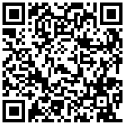
Get This Entire Presentation
http://bit.ly/twitter101va

Slide 2
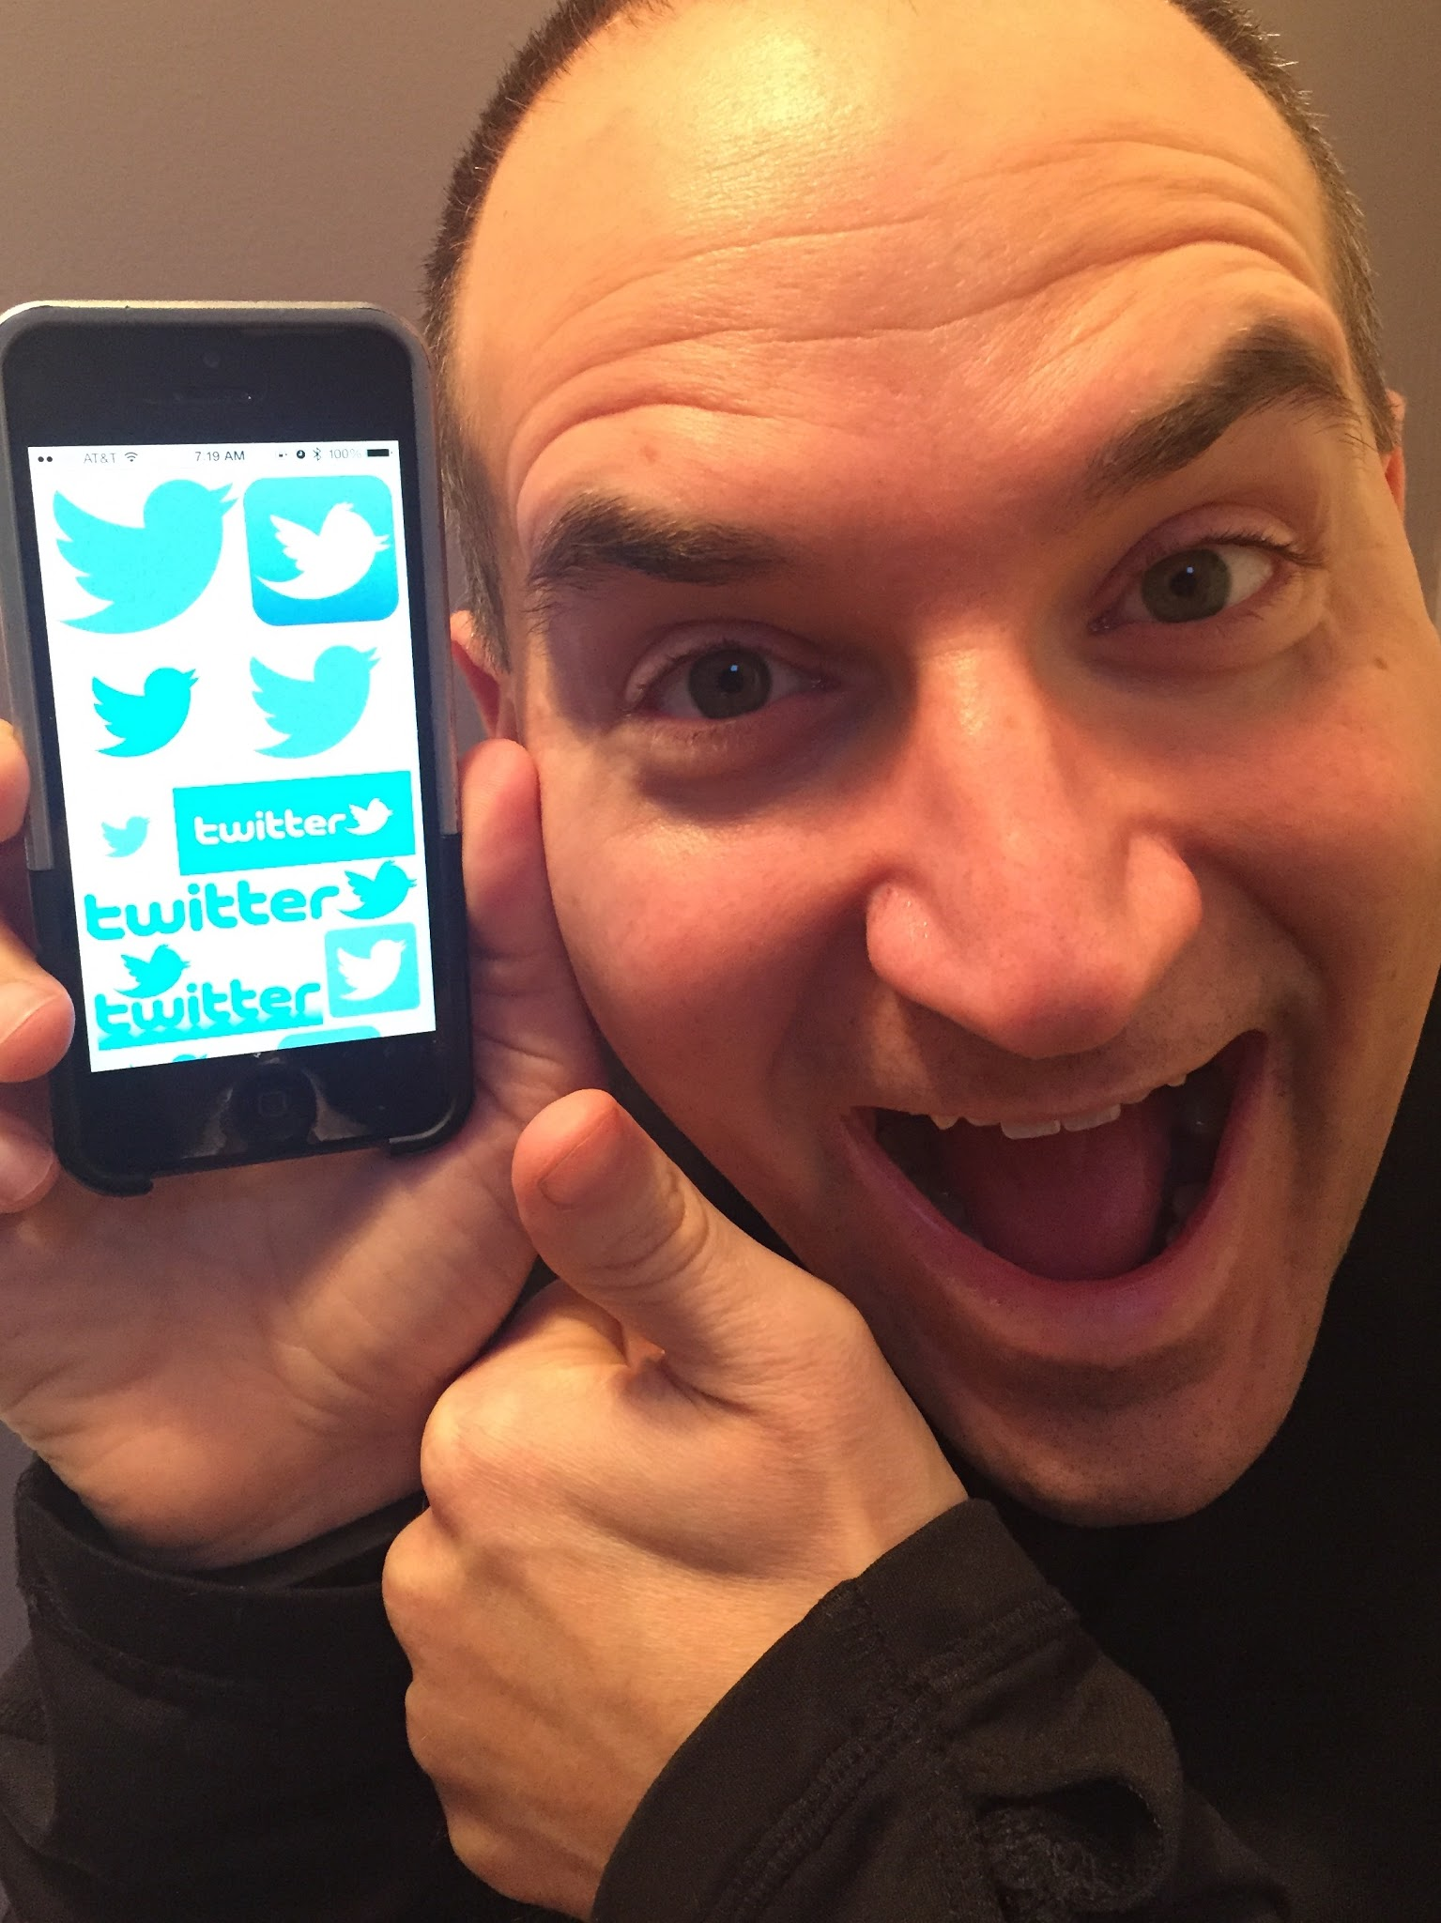
Twitter 101
Christopher Bugaj
On Twitter: @attipscast
attipscast@gmail.com
attipscast.com
2
Notes:
2

Slide 4
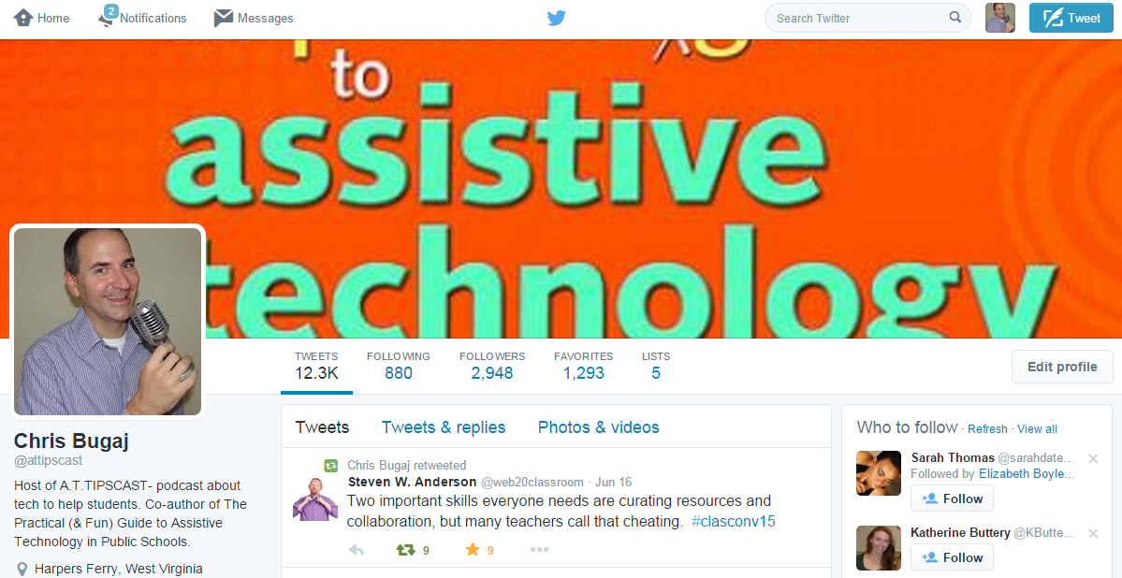
Talk the Talk
tweets
followers
following
@
search
#
chats
Notes:
What is it? Why is it important? How can it be used?
Start passively
(receptively) and
then start interacting (expressively).

Slide 5
What is a “Tweet”
Short posts (often 140 characters or less)
Text & links to audio, images, and/or videos (and polls!)
Develop a list of friends or followers

Slide 6
Why Tweet? Let’s fill this in together!

Slide 7
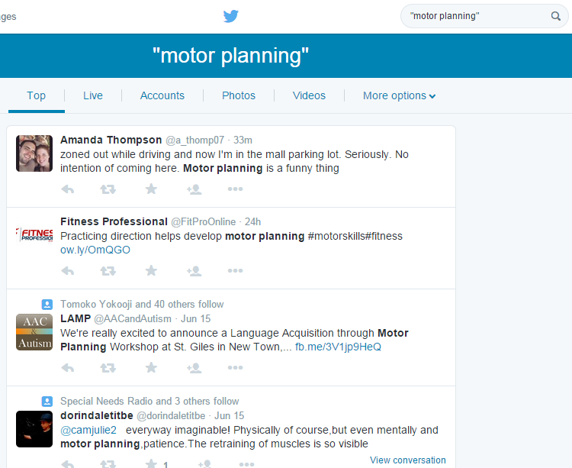
Search
Find topics
Find people

Slide 8
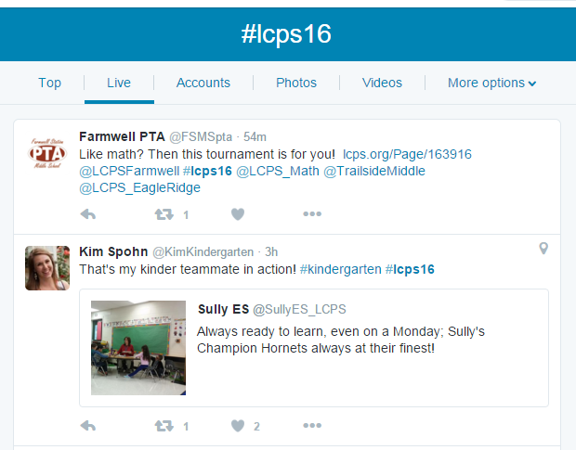
Using Hashtags- “#”
Search for specific info
Conversation around an event or idea
Find similar topics
Cleverly explain yourself
#lcps16, #lcps2020, #OTTW, #techk15

Slide 9
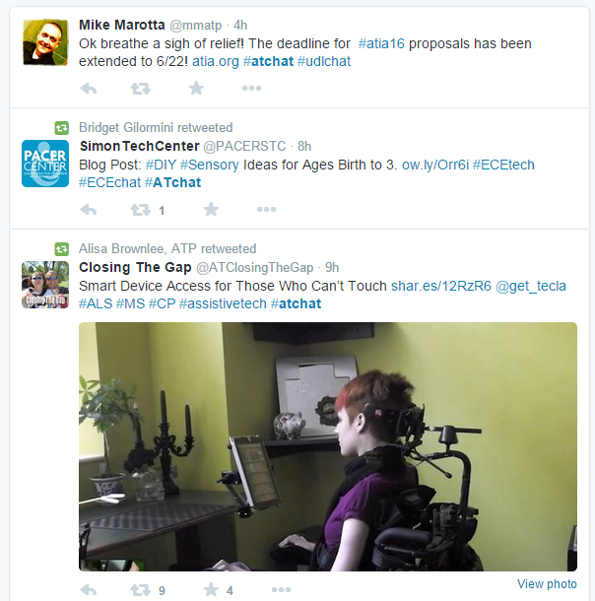
Chats - http://bit.ly/epictwitteredchats
#ATChat
#EDChat
#UDLChat
#CTDTechTalk
#SPEDChat
#LCPSEDCHAT
Often has a set topic
May have a set time
Often has a facilitator

Slide 10
Who to Start Following...
@attipscast - Chris Bugaj
@nightlight08 - Melissa Bugaj
@possbeth - Beth Poss
@karenjan - Karen Janowski (UDL and AT)
@iplante - Sharon LePage Plante (LD)
@ewilliams65 - Dr. Eric Williams

Slide 11
Even More People To Start Following
Who was missed?
Let’s list some here!

Slide 12
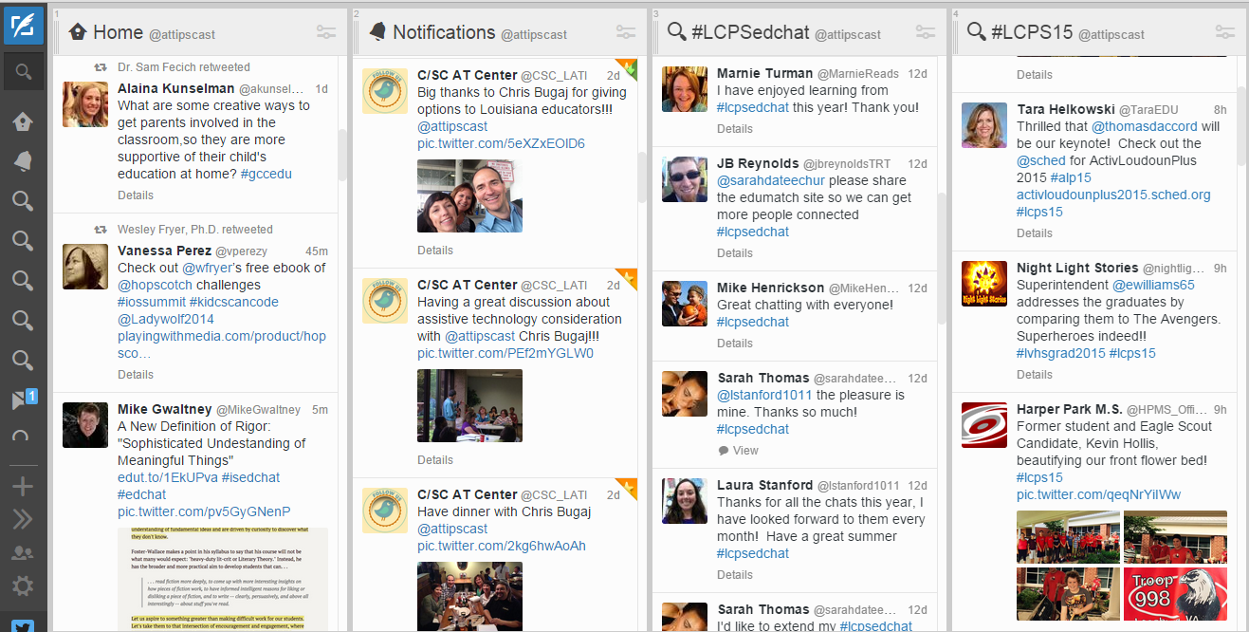
Twitter Management Resources
TweetDeck
Hootsuite

Slide 13
Become A Wizard!
Explore Social Networking Sites
Sign up for Twitter
Follow some folks
Look up hashtags
Tweet something you want to share
Participate in a chat

