Slide 1
No Chromebooks, No problem!
Not a Google apps for Education division? you’re in luck! PCs and macs are accessible too!

Slide 2
Matt Newton, M.A.T.
Coordinator of Assistive & Educational Technology at VDOE’s T/TAC at Virginia Tech
Formerly a Special Education Teacher and ITRT with Roanoke City Public Schools

Slide 3
AGENDA
Windows-based PCs & Office Products (including 365)
Apple MacOS and iOS Devices

Slide 4
There used to be “an app for that” Now, there is an “extension for your intention”

Slide 5
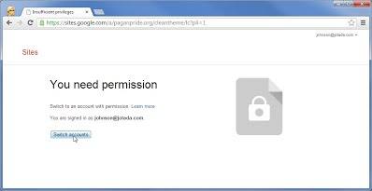
But want can if you can access them on your school’s network?

Slide 7
But wait! The operating systems on the devices you have already have built-in accessibility features!

Slide 9
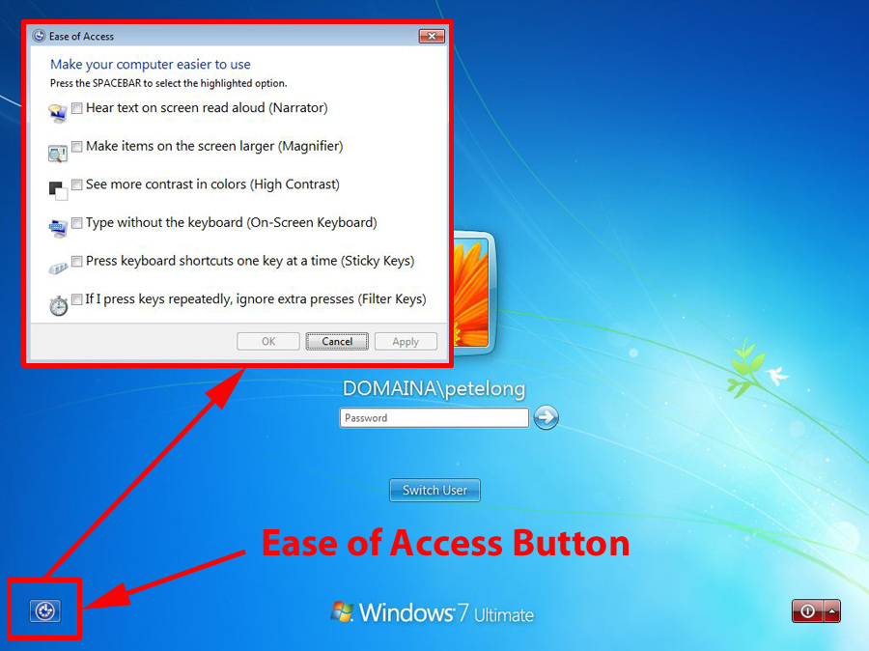

Slide 10
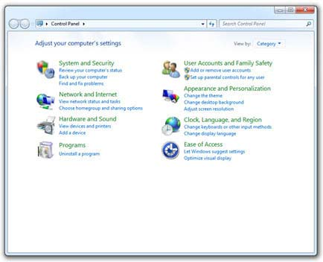

Slide 11
Microsoft’s Ease of Access Center
Magnifier – Also increase text size
High Contrast Mode
Narrator
Sticky, Toggle, or Filter Keys (as well as keyboard shortcuts)
On-screen keyboard (great for touchscreen devices)
Change mouse controls (exp: change pointer size or move the mouse with keypad)
Visual sound alternatives (such as a flash on the screen for notifications or a text caption for a print job beginning or ending.
Clean up the clutter (desktop, start menu, and reader view in browsers)
Speech Recognition
Cortana and Hello (Windows 10 only)
Recommendations to make your computer easier to use.

Slide 12
office Software Accessibility (365, 2013 and newer)
Use keyboard to move around the ribbon
Keyboard shortcuts
Zoom in or out of document
Read Mode
Autocorrect spelling
Speech Recognition
Speak text
Built-in translator
Create accessible documents
Use “Tell Me” Alt+Q (Office 365 only)

Slide 13
Browser accessibility
Zoom on a webpage
Make text larger or smaller
Use keyboard to surf
Change font, formatting, & page color
Screen reader and voice recognition software compatibility

Slide 14
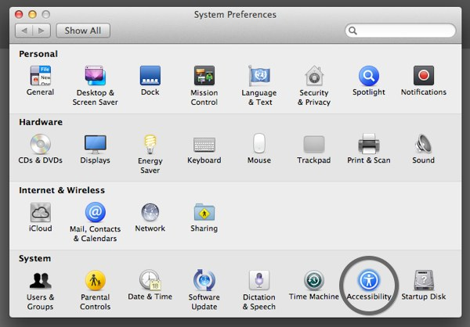
Mac os

Slide 15
Safari – Reader view (Mobile too!)

Slide 16
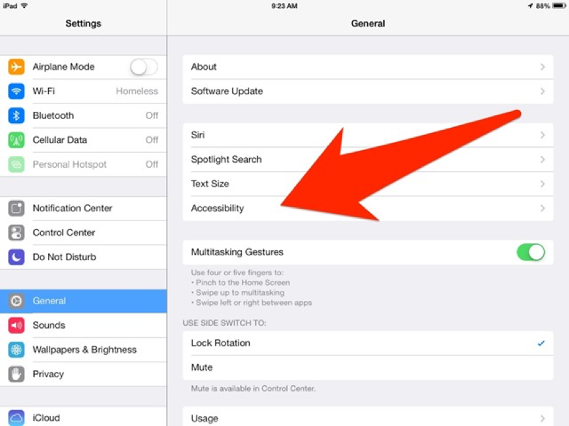
i-OS ACCESSIBILITY
Features have been around since iOS 7 (we are now on iOS 10), so you may be familiar with many of them.
New features included in the new iOS 10 update:
Magnifier
Display Accommodations
Speech Enhancements & New Voices
VoiceOver Pronunciation Editor

Slide 17
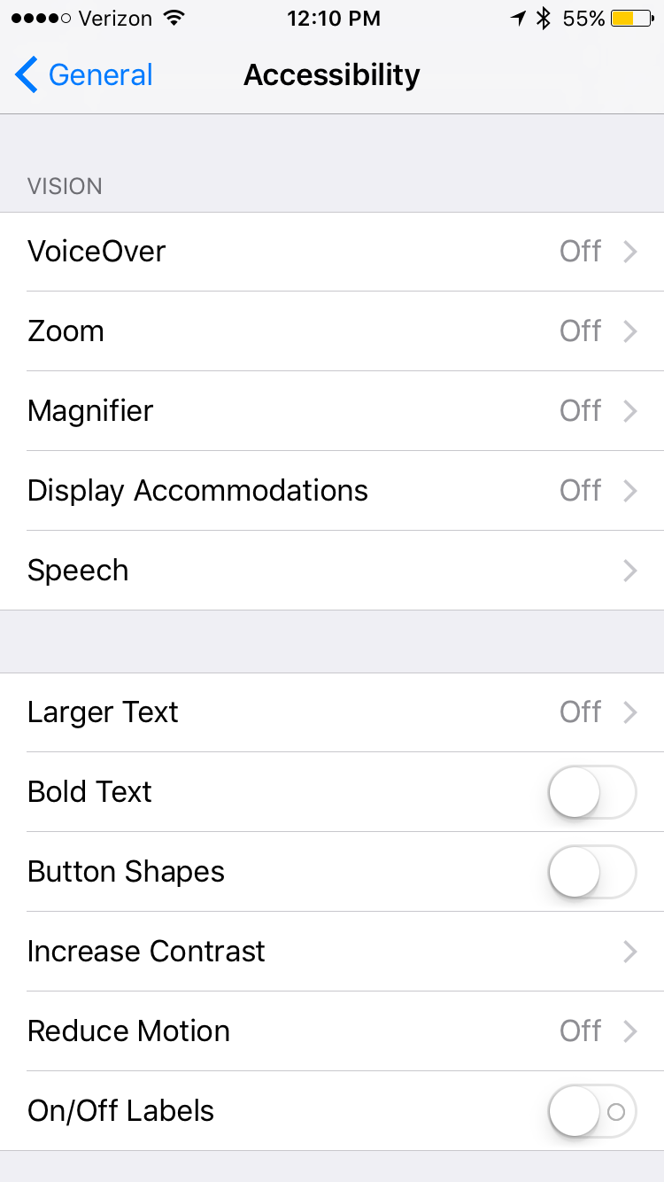
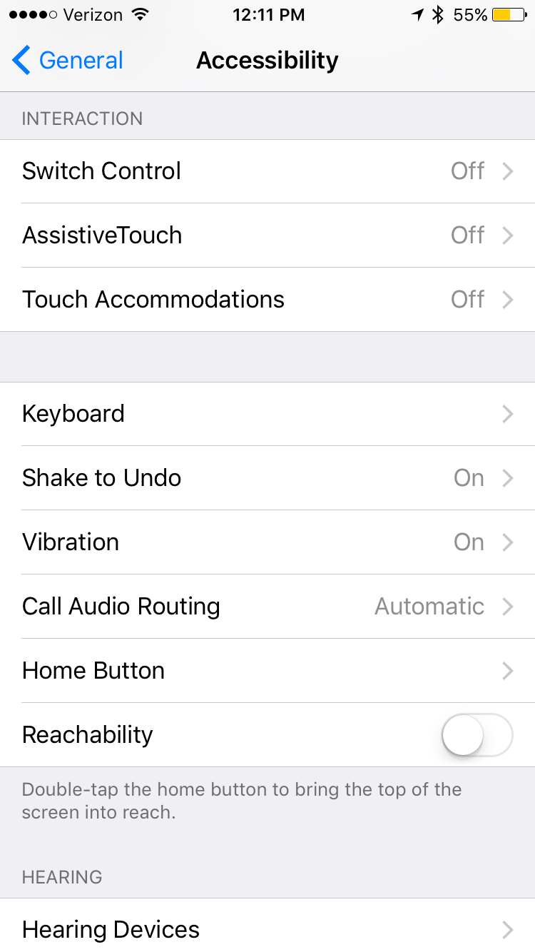
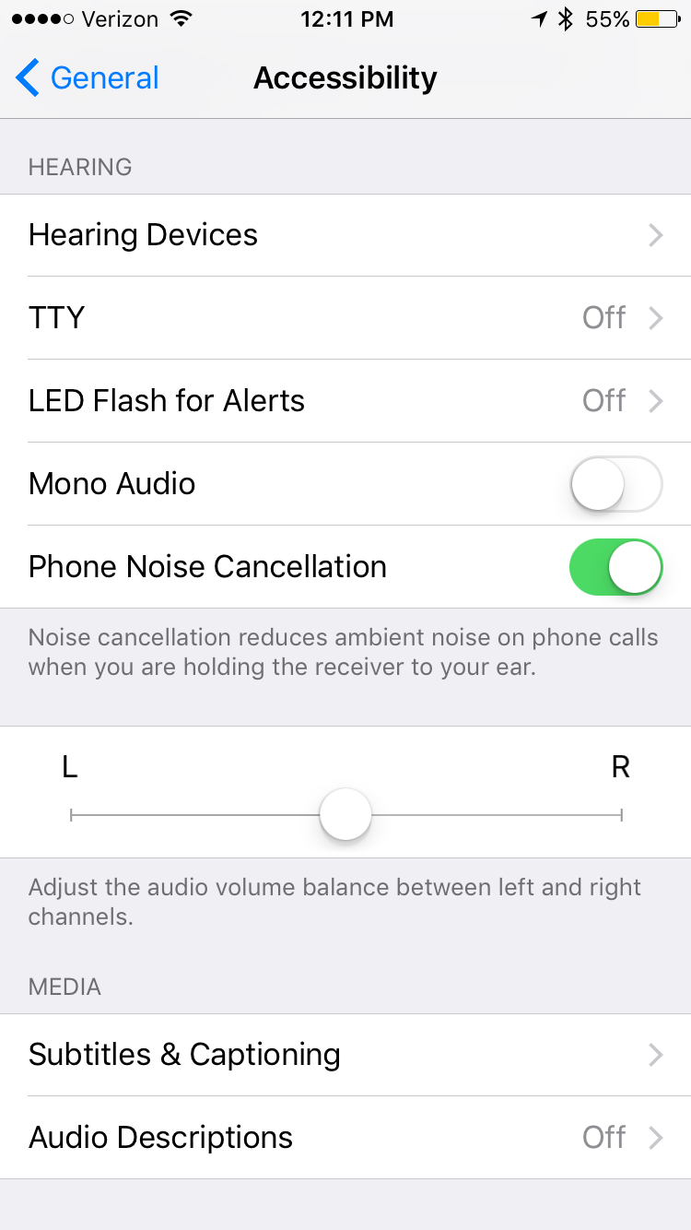
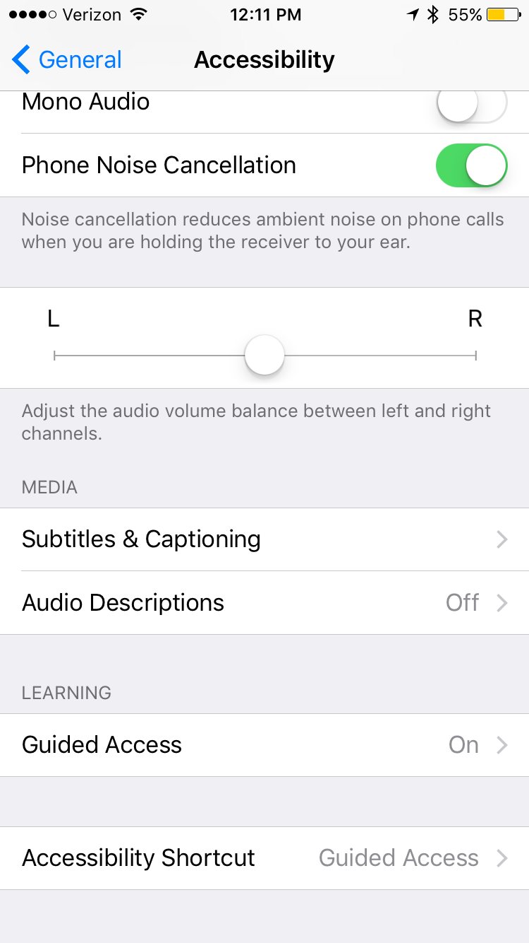
Accessibility features within ios

Slide 18
Resources
https://www.microsoft.com/enable/products
Microsoft Disability Answer Desk: 800-936-5900
https://support.microsoft.com/en-us/answerdesk/accessibility
http://www.apple.com/accessibility/

Slide 19
Using built-in Accessibility features can get your students up and running more quickly and for less cost!

Slide 20
Questions?

