Slide 1
Web Accessibility
Presented by
Kristine Neuber, Ph.D
IT Accessibility Coordinator

Slide 2
Web Accessibility: What does it mean?
Web accessibility means
People with disabilities can perceive, understand, navigate, and interact with information on the web.
Regardless of their disability or the technology they use to access the site.

Slide 3
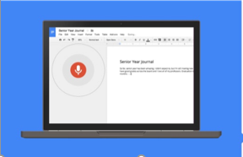
Types of Impairment and Assistive Technology
Sensory (Loss of vision, hearing, or both)
Screen readers and refreshable braille devices for people who are blind or have other print disabilities
Captioning for people who are deaf
Learning/Cognitive
Text to speech software, Organization and Structure
Physical
Alternatives input tools, such as speech-to-text software, for people who cannot use a computer mouse
Notes:
Notes
I have listed 3 classifications here..,while there’s certainly a great deal of variation that exists under these 3 classifications, they do broadly cover much of what we are discussing here today.
When we discuss inaccessible EIT, make no mistake that 99% of the discussion (from a legal standpoint) centers around equivalent access for individuals with some degree of vision and/or hearing loss...Now, there’s only one case that I can think of which actually involved individuals with learning impairments (that was UC Berkeley and involved more timely access to printed materials in alternative formats like Braille, audio, or large print)...
So, if we move beyond thinking about the discussion in terms of disability and more about the types of assistive technology that an individual uses in order to access a computer, things start to make a bit more sense.
How instructional materials and/or our electronic resources are designed play a significant role in one’s ability to access information or participate in the programs or services that we offer...
If I am blind, I need a screen reader to access a computer and to read electronic documents
If I am deaf or hard of hearing, I need captions and transcripts for audio and video
If I have a learning impairment, I benefit from information being presented in a consistent manner and chunked so as to allow me an easier time processing that information
If I have a physical impairment which impacts my ability to use a mouse or a keyboard, I also benefit from how a document or website is structured since I too would require an alternative means for accessing a computer.

Slide 4
Legal Requirements
Americans with Disabilities Act (ADA) Title II
Prohibit discrimination based on disability – regardless of funding
Section 504 of the Rehab Act
Prohibit discrimination based on disabilities for entities receiving federal funds
Both
Opportunity to participate in programs, services & activities
Include programs, services and activities delivered online

Slide 5
Applicability in the K-12 Environment
School systems depend on the web to disseminate information.
Provide instructional materials through course management tools like blackboard.
Real-time communications/information (school closings and emergencies).

Slide 6
Office of Civil Rights (OCR) Complaints
The Office of Civil Rights has reached several settlements to ensure website accessibility for people with disabilities.
AK - Juneau School District
GU - Guam Department of Education
MT - Montana School for the Deaf and Blind
NM - Santa Fe Public Schools
NV - Washoe County School District
NV - The Davidson Academy of Nevada
NV - Nevada Department of Education
OR - Oregon Department of Education
UT - Granite School District
VA - Virginia Beach City Public Schools
WA - Bellingham School District
WA - Washington Office of Superintendent of Public Instruction
K-12 Education Web Accessibility Compliant Repository
https://www.audioeye.com/k-12-education-web-accessibility-complaint-repository/

Slide 7
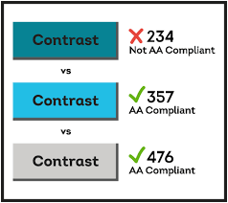
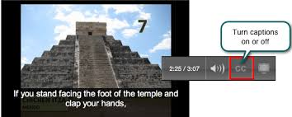
Main Issues Identified in Complaints
Only accessible with a mouse
Alt-text: Grady as a puppy
Images missing alternative Text

Slide 8
Accessibility Guidelines
WCAG 2.0 Guidelines
Web accessibility initiative of the World Wide Web Consortium “W3C”
Public/private consortium, world-wide, of academics, governments, technology industry, and user groups
Section 508 Only Applies Directly to the Federal Government
Federal agencies must comply with the Section 508 standards
Others may use the Section 508 standards as guidance
Section 508 Resources:
www.section508.gov
www.access-board.gov
Section 508 (issued 2001) or WCAG 2.0 (issued 2008)
Final rule for 508 Refresh incorporates WCAG 2.0 Level AA
Was released on January 17 – Compliance will be expected by Jan 17 2018

Slide 9
Overview of Common Components
Images from the Web Accessibility Handbook (Portland Community College)

Slide 10
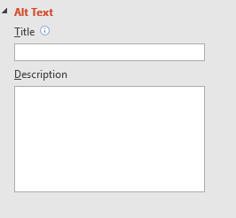
Web Accessibility - Images
Images should have meaningful labels:
Ex. Fingers scanning a refreshable Braille display.
Not: Image
Long Descriptions are needed for charts or graphs…

Slide 11
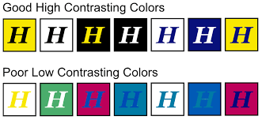
Web Accessibility – Use of Color
Provide adequate color contrast for text and buttons.
Meaningful information should be conveyed through more than just color.
For example, individuals unable to identify color would not know which fields were required. A simple fix would be to add an asterisk(*) next to the required fields.

Slide 12
Web Accessibility - Video
All controls accessible via keyboard
Synchronizedaaudio description
Accurate, synchronized Captions
Interactive Video Transcript

Slide 13
Web Accessibility - Keyboard
Users should be able to “tab” through the page and get to all information and functions.
Pages should not require users to manipulate a mouse for navigation.

Slide 14
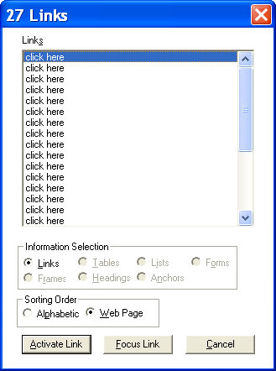
Web Accessibility – Links & Headings
Use Meaningful Names to identify links
English homework
For English Homework click here
Screen readers allow users to get a list of links, If they all say click here the user will not know what information they will get.
Provide Structure to content using headings
A screen reader will allow the user to jump to different headings on the page.

Slide 15
Jaws Screen Reader Demo
Navigating a Word Document (a screen reader user’s perspective)
Video courtesy of High Tech Center at Taft College: https://www.youtube.com/watch?v=D8XFkGMF0sw

Slide 16
Web Accessibility - Tables
Table headers must be identified
Screen readers look for <th> to identify which cells in the table are rows or columns allowing them to be read logically.

Slide 17
Web Accessibility - Forms
Form elements on a web page should be Keyboard Accessible
Must have labels and instructions associated with the input field
<fieldset>
<legend>Shipping Address:</legend>
<div>
<label for="shipping_name">

Slide 18
Where to Start?
Identify your team.
Develop accessibility and procurement policies.
Evaluate websites and other electronic resources.
Prioritize remediation.
Publish a statement and where to report issues.

Slide 19
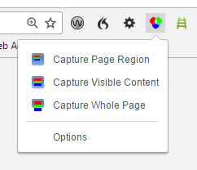
Web Accessibility Testing Tools
Wave Tool: http://wave.webaim.org/
Wave Chrome Extension: http://wave.webaim.org/extension/
Color Contrast Analyzer: Chrome Extension
Siteimprove: Chrome Extension

Slide 20
Resources
Captioning YouTube Videos:
http://ncdae.org/resources/cheatsheets/youtube.php
K-12 Education Web Accessibility Compliant Repository
https://www.audioeye.com/k-12-education-web-accessibility-complaint-repository/
School Website Accessibility Tips
http://www.schoolwebmasters.com/School_Website_Accessibility_Tips
School Website ADA Compliance Accessibility Guide
http://content.campussuite.com/ada-guide
Web Accessibility Checklists
Section 508 http://webaim.org/standards/508/508checklist.pdf
WCAG 2.0 http://webaim.org/standards/wcag/WCAG2Checklist.pdf
Web Accessibility Evaluation Tools
https://www.w3.org/WAI/ER/tools/
WebAIM
http://webaim.org/
Web Content Accessibility Guidelines (WCAG 2.0)
http://www.w3.org/TR/WCAG20/

Slide 21
Contact Information
Kristine Neuber, Ph.D.
IT Accessibility Coordinator
Assistive Technology Initiative
George Mason University
Fairfax, VA 22030
kneuber@gmu.edu
Phone: 703-993-9815
http://ati.gmu.edu
Twitter: @AccessibleMason

